Slide 1


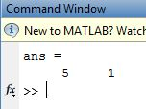

ECE 101 Matlab Assignment #7
Ryan M Fenn
Due December 7, 2011

